Slide 1
PROF. A. RAMEEZA,
PG & Research Department Of Commerce (SF-W)
Jamal Mohamed College,
Trichy-20.

Slide 2
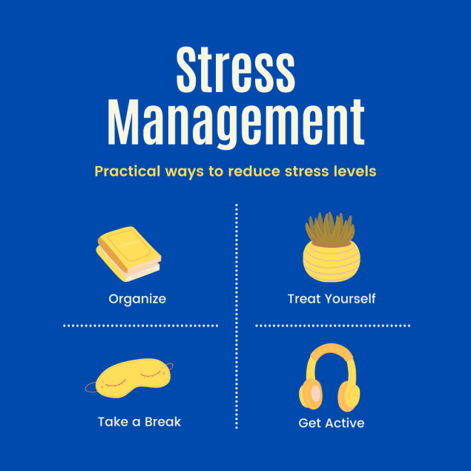

Slide 3
Stress
Stress is a feeling of emotional or physical tension. It can come from any event or thought that makes you feel frustrated, angry, or nervous.

Slide 4
Features of Stress
• Stress is both psychological and physical aspect.
• It is common to both the genders.
• It results from the deviation of expectations from actual situation.
• It is symptomatic. Potential stress appears with the symptoms. If the potential stress is ignored it leads to actual stress.
• Stress is treated to be negative. Nevertheless, it has positive consequences. This is called as eustress.
• Stress is an interactive concept. It does not spring from the internal organs of the individual. It comes from the interaction of the human being with the environment. Thus, environment has a profound influence on the stress.
• Stress is generic term. If it is applied to the context of organisation, it is known as work stress or job stress.
• Stress occurs only when the human being feels mediation of the internal or external factors.
• Stress is related to the attitude of the person. Stress does not occur when the person is having an indifferent attitude to the opportunity.
• Stress is associated with certain common biological disorders such as heart attack, stroke, diabetic, blood pressure, neurological disorders etc.

Slide 5
Some common signs of stress include:
Changes in mood
Clammy or sweaty palms
Decreased sex drive
Diarrhea
Difficulty sleeping
Digestive problems
Dizziness
Feeling anxious
Frequent sickness
Grinding teeth
Headaches
Low energy
Muscle tension, especially in the neck and shoulders
Physical aches and pains
Racing heartbeat
Trembling

Slide 6
Types of Stress
Not all types of stress are harmful or even negative. Some of the different types of stress that you might experience include:
Acute stress
Chronic stress
Episodic acute stress
Eustress

Slide 7
Acute stress:
Acute stress is a very short-term type of stress that can either be positive or more distressing; this is the type of stress we most often encounter in day-to-day life.
Chronic stress:
Chronic stress is stress that seems never-ending and inescapable, like the stress of a bad marriage or an extremely taxing job; chronic stress can also stem from traumatic experiences and childhood trauma.

Slide 8
Episodic acute stress:
Episodic acute stress is acute stress that seems to run rampant and be a way of life, creating a life of ongoing distress.
Eustress:
Eustress is fun and exciting. It's known as a positive type of stress that can keep you energized. It's associated with surges of adrenaline, such as when you are skiing or racing to meet a deadline.

Slide 9
Stress management
Stress management is defined as the tools, strategies, or techniques that reduce stress and reduce the negative impacts stress has on your mental or physical well-being.
A variety of techniques can be used to manage stress. These include mental, emotional, and behavioural strategies.

Slide 10
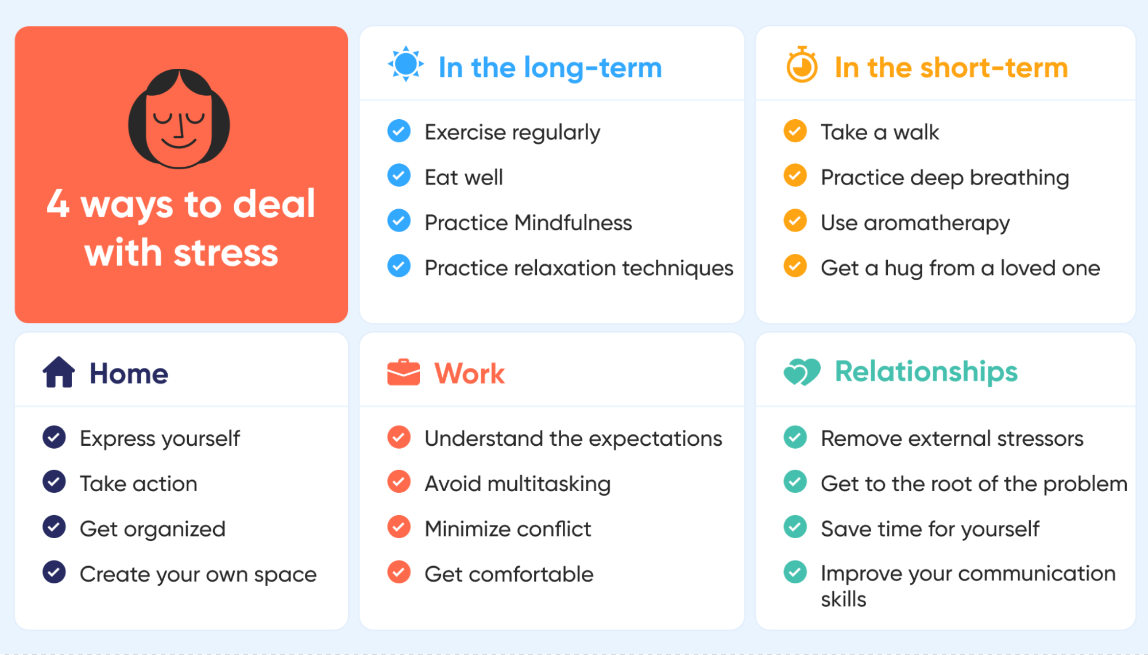
Stress Management Strategies

Slide 11


